Slide 1
Innerarity Island Gate System
December 2018

Slide 2
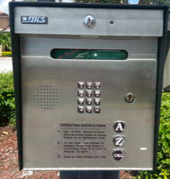

Gate Info
&
Updates
Gate system has been installed, tested and ready to activate! Volunteers spent multiple weekends and evenings testing the system and making tweaks, changes and rework to assure all is working.
Common Questions…….
Gate codes - all the original resident 4 digit access codes will work.
  Code can be changed if desired
Key Fobs will still work (until 1/15/2019)
Is the new pedestal keypad box new? (looks the same but is completely new, rewired/grounded and using updated technology)
RFID Stickers are in Beta Test phase this month
New ground
Minus Shock

Slide 3


What has changed?
Gate Service
  The access administration is now being done on the island via gate committee volunteers instead of Johnson.
    Benefits:
      100% reduction of vendor fees
      Reduction in telecom fees
      Far quicker response to access requests
      Ability to create contractor codes with termination dates
      Ability to open and close gates remotely without a vendor request & fees
      Significantly better security data and user control

Slide 4



What has changed?
Significantly Better Gate Security
  One car at a time only
  Each car has is identified as a permitted resident via RFID or Keypad access.
  No more long line of cars “piggy backing” through one residents access code.
  All primary builders/contractors now have their own codes identifying them & their sub-contractors
  No more shared codes
  No need to give out your code, just give them your directory code and open the gate from anywhere in the country to let them in.
  Long term contractors? We can provide temp codes now
  School bus drivers now have access, no longer need to keep the gates open during school hours!
  Reduction in repair costs due to mechanical wear

Slide 5


What has changed?
Gate Type
The new gate is a barrier gate as opposed to the old swing gate, meaning an arm comes up and down to prevent vehicle access instead of a larger gate swinging open. This forces a 1 vehicle at a time rule .
The gate motors use magnetic technology that reduces wear and tear of that the old gate motors & gears.
The gate arms have LED lighting at the bottom edges of the arms to signal open and closed positions.
  Red lighting will be activated when the arm is closed or in process of closing.
  Green lighting will be activated when the arm is open or in process of opening.
  The entrance gate will close with each car so prepare to stop and allow the gate to close behind the car in front of you and reopen for you.
  Gate arms do have a protective foam pad incase they come into contact with a car and will immediately bounce back upward.

Slide 6
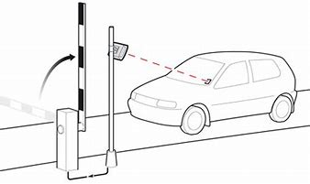
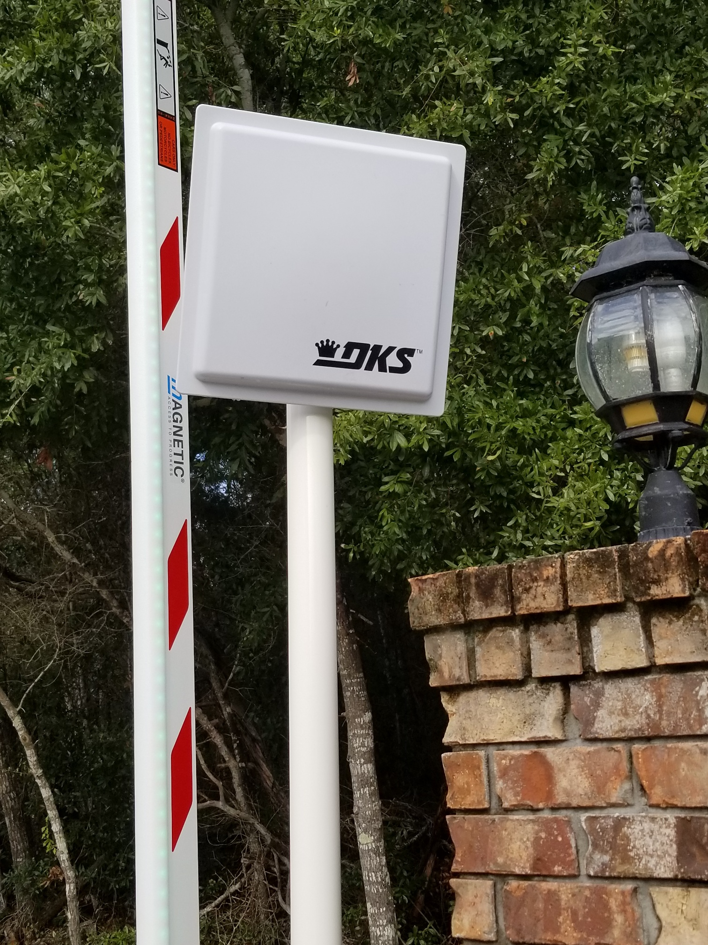

What has changed?
Card Reader
RFID tag reader
  The new system will automatically read RFID stickers placed on the passenger side windshield.
  RFID Reader is on the right side of the gate. (gray box)
  Reader is set to pick up your car after you pass the speed bump and around the keypad area. You will hear a beeping sound once the reader picks up your car.
  Allows us to migrate off of the key fobs
  Hands free technology

Slide 7
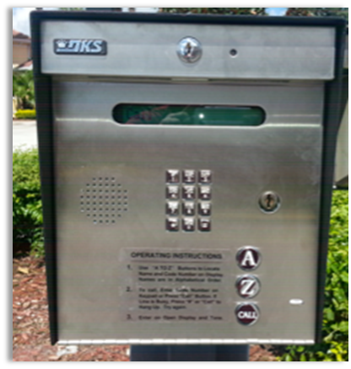
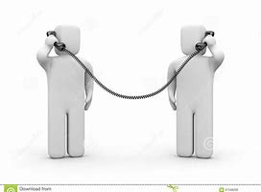
What has changed?
Tip: Add the gate
# to your phone contacts so it shows up as the gate calling.
Call button
Guest Call from the gate to gain access
  Guests (pizza delivery, in-laws, repair contractors, etc.) can look you up in a directory via the access panel (A or Z buttons to help scroll through the directory)
  Guests can be given your 3 digit directory code in advance
Steps to call for gate access
  Simply enter your 3 digit directory code and press the call button
  The system will call the number associated to your directory code
  The number 850-450-1169 (gate) will call your phone.
  Intercom will allow the person at the gate and you to communicate, simply press the number 9 on your phone keypad and the gate arm will immediately open!

Slide 8

How to get in & out
  Steps for Entrance to the Island
  Slow down before the new speed bump
  Key fobs will work only once you pass over the speed bump, sensitivity was reduced to assure the gate opens right as you pull up the gate key pad pedestal.
  Pull up to the keypad pedestal to use the keypad to open the gate or for the RFID reader to have the best angle to sense and read the RFID sticker on the windshield.
  A beep sound will alert you that the access code, key fob or RFID sticker has caused the gate arm to open. The gate arm LED lights will turn green when opening/open.
  Proceed through the gate. The gate will close behind you with the LED lights turning red to alert that the arm is closing.
Steps for Exiting the Island
Slow down before the speed bump
Once passing over the speed bump your car will drive over a sensor under the pavement that will cause the gate arm to open. The gate arm is safe to pass through once the LEDs are green.
The LEDs will turn red when the arm is closing/closed.

Slide 9

Next Steps
Update residents' information in the new system
  Assure 4 digits access codes for each owner
  Provide 3 digit directory codes for each owner
  Update owner phone numbers
Roll out of RFID stickers
  1 Sticker for each vehicle, mount to the upper right side area of the windshield, out of the path of the wipers and away from the metal trim of the windshield.
  RFID stickers can be picked up via Kevin Wilband
    Kwilband@yahoo.ca / #319-561-0254
Tweak as needed, as in any new system, we learn from use and will tweak as needed along the way.
Addition of new codes for temporary needs, vendors and others needs.
Elimination of generic codes
Patience as we activate the gate, remember this is being worked on my volunteers at have day jobs & families

Slide 10
Questions?
Additional Information on www.innerarityisland.org

